Slide 1

Hidden Markov Model
Solve Real life problem using these Algorithms
Given a HMM and observation sequence
Find the optimal Hidden state sequence
Calculate Probability of observations
Find Current Hidden State
Estimate Next Hidden State
software Demo

Slide 2


Institution Information Technology
Software Project Lab 1
-SE 305

Slide 3
Software Project Lab 1
Implementation of Hidden Markov Model
submitted by Supervised by
Md. Ibrahim Khalil Dr. Ahmedul Kabir
BSSE 1009

Slide 4
Hidden Markov Model
Introduction
What‘s HMM?
A Statistical Model
A formal foundation for making probabilistic models of
linear sequence
predict a sequence of unknown (hidden) variables from a set
of observed variables
Applied in a wide range of applications
Applications:
Speech recognition
Handwriting recognition
Bioinformatics

Slide 5
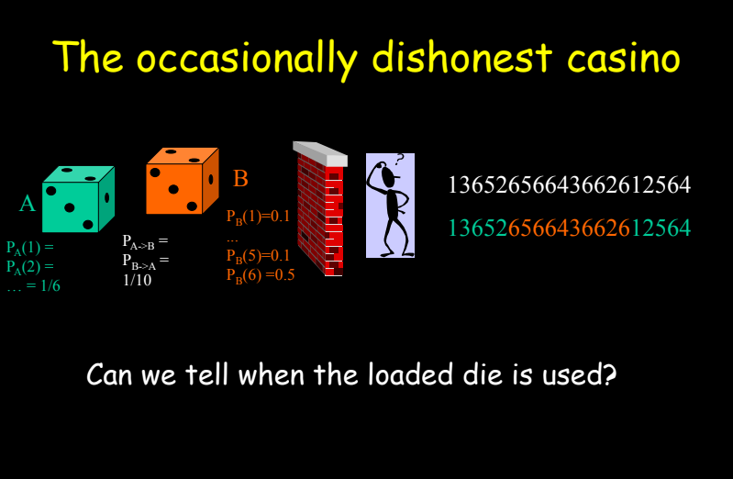
Hidden Markov Model
Introduction
What‘s HMM?
A Statistical Model
A formal foundation for making probabilistic models of
linear sequence
predict a sequence of unknown (hidden) variables from a set
of observed variables
Applied in a wide range of applications
Applications:
Speech recognition
Handwriting recognition
Bioinformatics

Slide 6
Hidden Markov Model
Introduction
A HMM ( ) is defined by 3 component
Starting probability (π )
Transition probability (A)
Emission probability (B)

Slide 7
Hidden Markov Model
My Implementation of HMM
About
The objective of my project is to allow users to create a
sample HMM.
User Can import a HMM and a Observation sequence
and perform these operation
Calculate probability of observation sequence
Generate optimal Hidden state sequence
Estimate most likely current Hidden state
Estimate optimal next Hidden state
The software aims to be as friendly to users without any coding
knowledge as with adept coders.

Slide 8
Hidden Markov Model
Software Demo

Slide 9
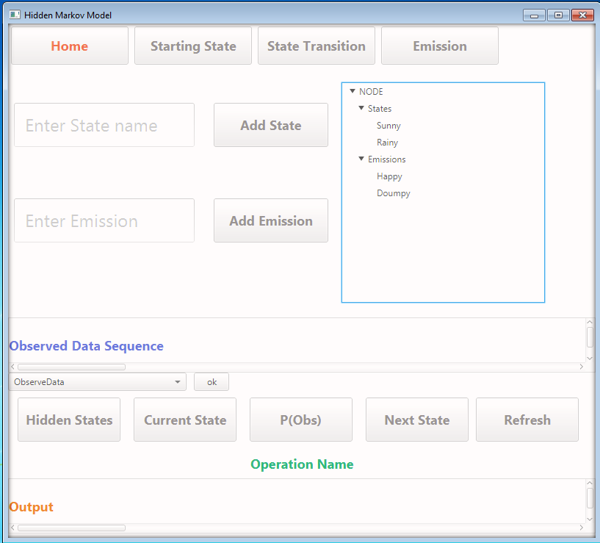
Hidden Markov Model
software Demo

Slide 10
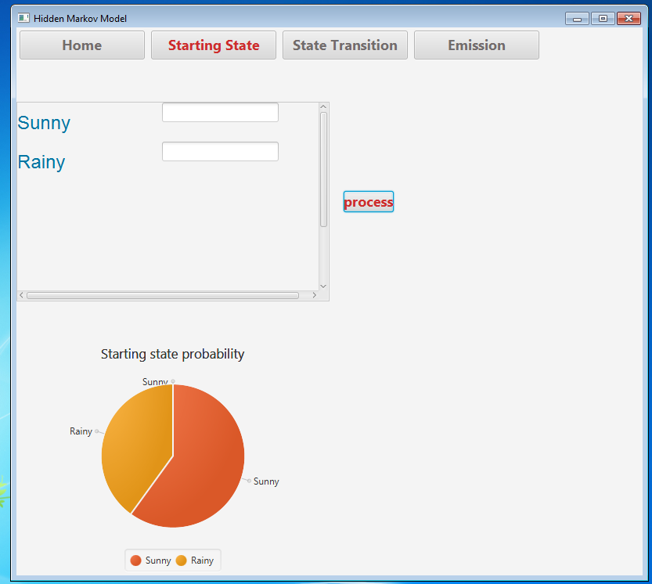
Hidden Markov Model
software Demo

Slide 11
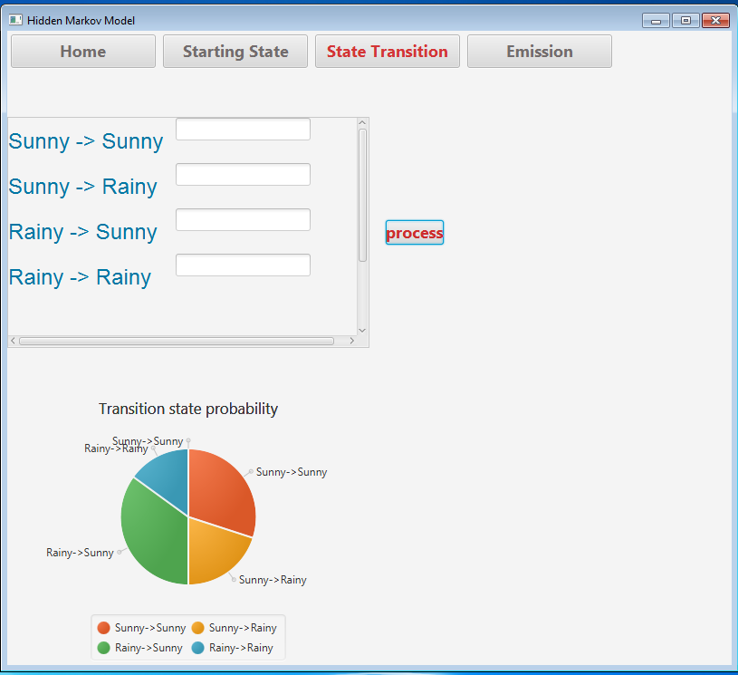
Hidden Markov Model
software Demo

Slide 12
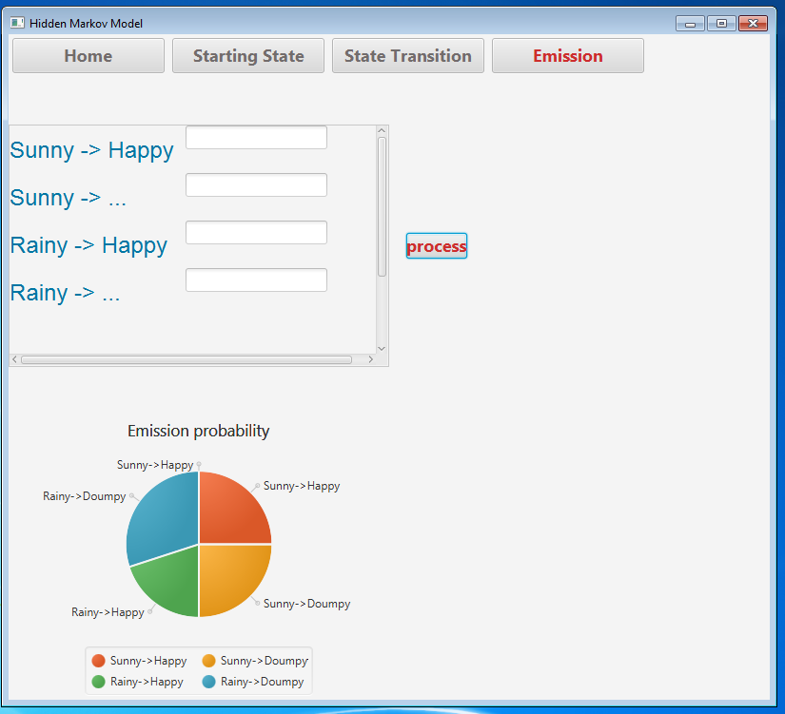
Hidden Markov Model
software Demo

Slide 13
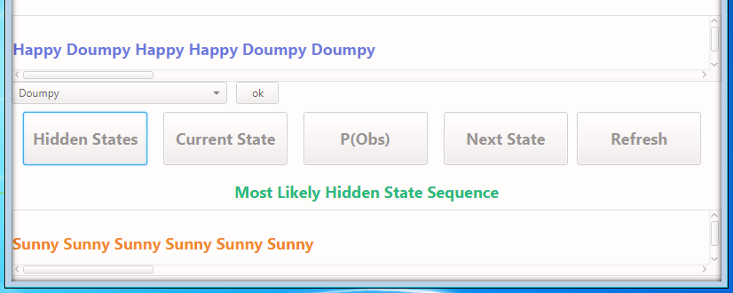
Hidden Markov Model
software Demo

Slide 14
Hidden Markov Model
Components (Build so far)

Slide 15
Hidden Markov Model
I divided my project into 3 components
Implementation of Algorithms
Connect Hidden Markov Model
With the algorithm
Implement GUI and Connect
The whole project

Slide 16
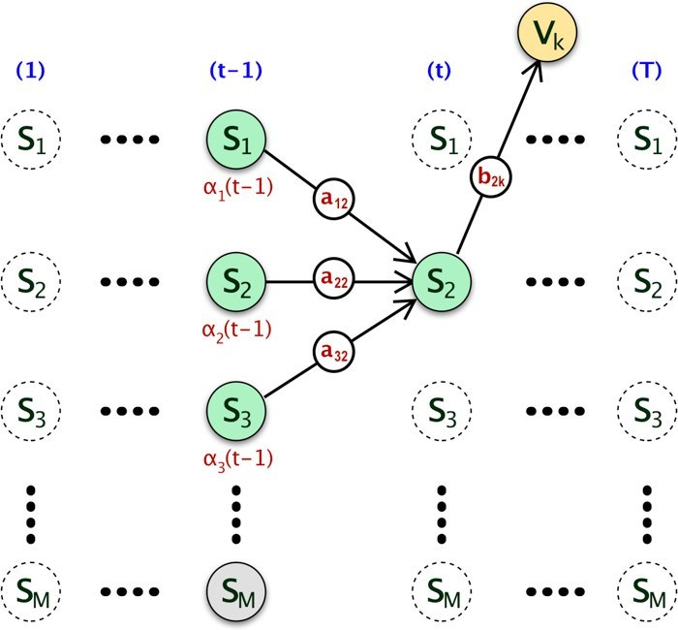
Hidden Markov Model
Algorithms
Forward Algorithm
By this algorithm I compute the probability of observation
sequence in O(N*N*T) complexity.

Slide 17
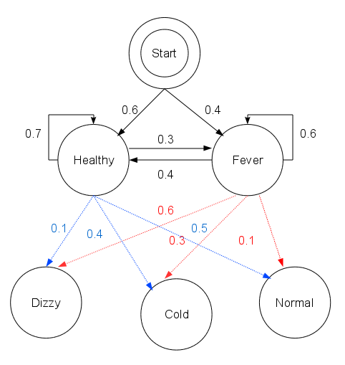
Hidden Markov Model
Viterbi Algorithm
The goal of the Viterbi algorithm is to discover the
optimal sequence of states given an HMM and a
sequence of observations
A graphical representation of a HMM :

Slide 18
Hidden Markov Model
Viterbi Algorithm
If an Observe sequence is ['normal', 'cold', 'dizzy'] and
try to decoding the Hidden States {Healthy, Fever} according
to the above HMM then we should use viterbi algorithm :
software Demo

Slide 19
Hidden Markov Model
Viterbi Algorithm
The above picture solve the decoding problem and
find the optimal hidden state sequence
['Healthy', 'Healthy', 'Fever'].
software Demo

Slide 20
Hidden Markov Model
Solve Real life problem using these Algorithms
Given a HMM and observation sequence
Find the optimal Hidden state sequence
Calculate Probability of observations
Find Current Hidden State
Estimate Next Hidden State

Slide 21
Hidden Markov Model
GUI Application
Let’s see how it works out!
Here is the jar file of my Software Application.

Slide 22
Hidden Markov Model
Further planned
features

Slide 23
Planned features: Scope
This project missing the training part of Hidden
Markov model. Within a Few days I want to
implement the training part and use this
algorithm in sign language detection.
software Dem

Slide 24
Hidden Markov Model
End product

Slide 25
Hidden Markov Model
End Product
End product is expected to be a user friendly HMM generator that can be used to solve many real
life markov problem.
User can train this model with any kind of data set.
software Demo

Slide 26
Hidden Markov Model
Github Repositories
https://github.com/bsse1009/SPL1 (before Mid)
https://github.com/bsse1009/SPL1-HMM
software Demo

Slide 27
Hidden Markov Model
“The best preparation for tomorrow is doing your best today”
software Demo

Slide 28
Hidden Markov Model
References
http://www.cs.cmu.edu/~awm/15781/slides/hmm14a.pdf
https://web.stanford.edu/~jurafsky/slp3/A.pdf
https://web.math.princeton.edu/~rvan/orf557/hmm080728.pdf
http://www.iitg.ac.in/samudravijaya/tutorials/hmmTutorialBarbaraExercises.pdf
software Demo

